Slide 1

PIZZA SALES ANALYSIS
SQL PROJECT
----Seema B-----

Slide 2

Hello!
Hi, this is my pizza sales analysis project in which I have utilized SQL server to deep dive into the date of a pizza brand

Slide 3
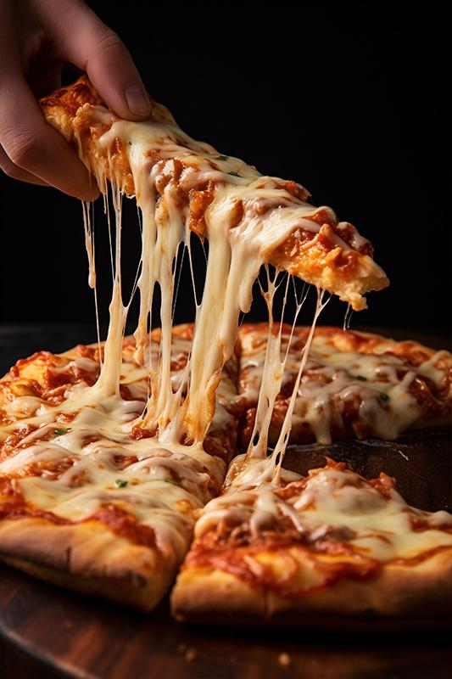
OBJECTIVE
The objective of this Pizza Sales Analysis project is to derive actionable insights from sales data using SQL.
This evaluates the key metrics like total orders and revenue. Identity popular pizza sizes and types, access revenue contribution.
Analyzing order distribution by time and date will optimize operations, while segmenting sales by categories will refine the product mix.
Advanced analysis includes tracking cumulative revenue and identifying the top-performing pizzas by revenue within each category.
This empowers data-driven-decision making to enhance sales and customer satisfaction.

Slide 4
Pizzahut Dataset
Order_details
Pizzas
Orders
Pizza_Type

Slide 5
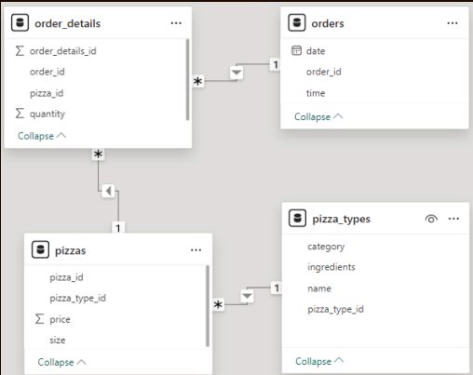



DATABASE SCHEMA

Slide 6
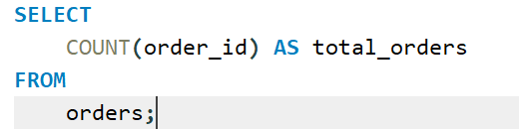
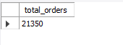
Retrieve the total number or order placed
Output --

Slide 7
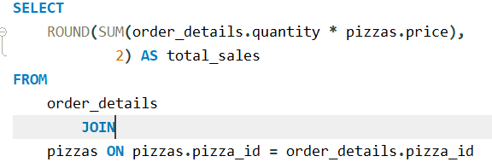
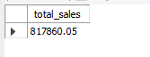
Calculate the total revenue generated from pizza sales
Output --

Slide 8
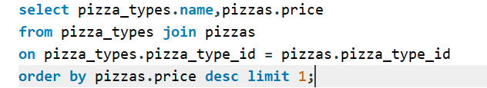
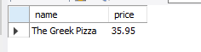
Identify the highest-priced pizza
Output --

Slide 9
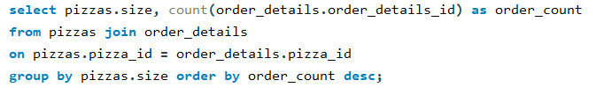
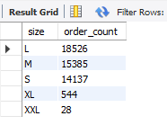
Identify the most common pizza size ordered
Output --

Slide 10
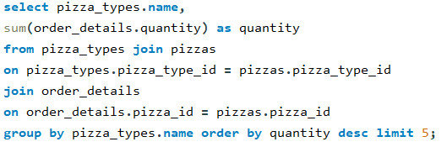
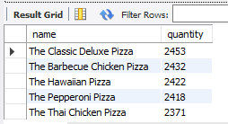
List the top 5 most ordered pizza types along with their quantities
Output --

Slide 11
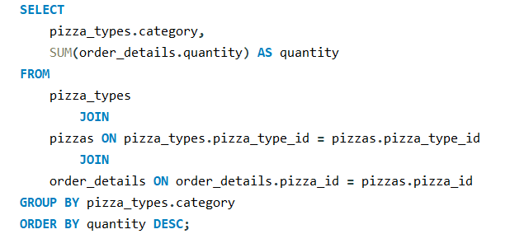
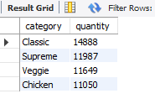
Join the necessary tables to find the total quantity of each pizza category ordered
Output --

Slide 12
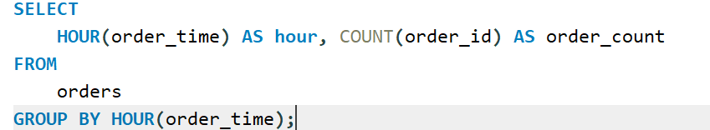
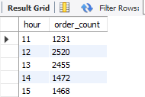
Determine the distribution of orders by hour of the day
Output --

Slide 13
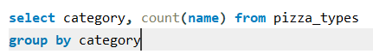
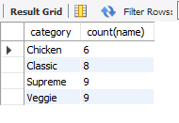
Join relevant tables to find the category-wise distribution of pizzas.
Output --

Slide 14
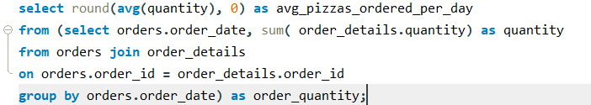
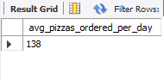
Group the orders by date and calculate the average number of pizzas ordered per day
Output --

Slide 15
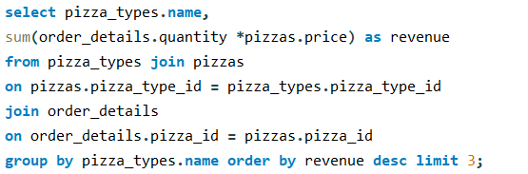
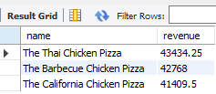
Determine the top 3 most ordered pizza types based on revenue.
Output --

Slide 16
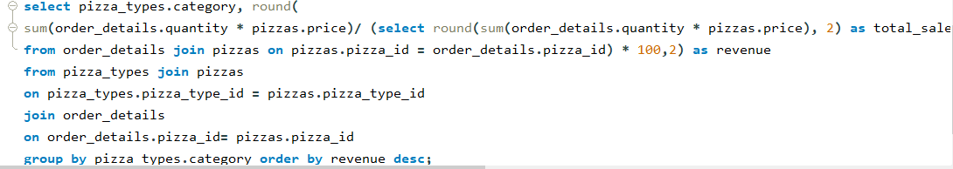
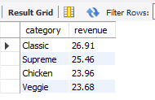
Calculate the percentage contribution of each pizza type to total revenue.
Output --

Slide 17
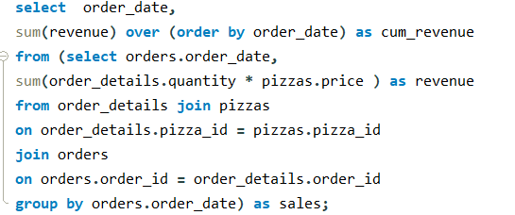
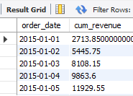
Analyze the cumulative revenue generated over time
Output --

Slide 18
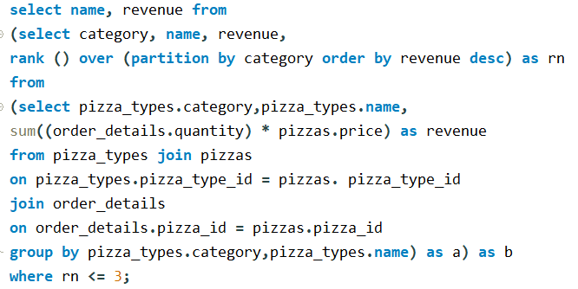
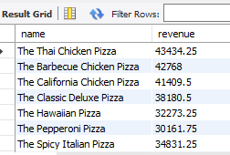
Determine the top 3 most ordered pizza types based on revenue for each pizza category.
Output --

Slide 19

Thank You

